Slide 1


BANGALORE TECHNOLOGICAL INSTITUTE Department of Computer Science & Engineering
AIRLINE MANAGEMENT SYSTEM
Presented by:
Mohammed Anees Ahmed-1BH20CS020
Manjot Singh-1BH20CS018
Submitted to:
Mrs. Saranya S

Slide 2
BANGALORE TECHNOLOGICAL INSTITUTE Department of Computer Science & Engineering
INTRODUCTION
A database management system (DBMS) is system software for creating and managing databases.
The most prevalent type of data management platform, the DBMS essentially serves as an interface between databases and users or application programs, ensuring that data is consistently organized and remains easily accessible.
Airline management system let’s users to book tickets, check schedules, or access nearest Airports etc. at any point of time.

Slide 3
BANGALORE TECHNOLOGICAL INSTITUTE Department of Computer Science & Engineering
DESCRIPTION
Development of a Airline Database is that it enables customer to maintain a database of them in the airline database which they can edit, update, delete and organize.
The database has the following tables in it for maintaining the data:
Airline
Airline Type
Airport
Booked Leg
Land
Crew
Customer
Flight
Flight leg
Ticket

Slide 4
BANGALORE TECHNOLOGICAL INSTITUTE Department of Computer Science & Engineering
TOOLS AND TECHNOLOGY
This particular use the following tools which makes the technology robust and efficient.
PHP
JAVASCRIPT-version
CSS
HTML
XAMPP
System Requirements:
Windows 7 and above
My SQL DB

Slide 5
BANGALORE TECHNOLOGICAL INSTITUTE Department of Computer Science & Engineering
EXIXTING SYSTEM
Currently there are multiple existing airline database management systems which keeps on improving day by day.
Indigo for example runs its own website where passengers can book their flight and their preferred seats in that particular flight.
There have been may complaints of slow webpage due to which passengers weren’t able to book the flight

Slide 6
BANGALORE TECHNOLOGICAL INSTITUTE Department of Computer Science & Engineering
PROBLEMS WITH EXISTING SYSTEMS
Flight booking services are used currently with the help of several travel agencies.
It’s not only causing inconvenience for customer but also raisins several tariffs that customer has to pay.
Through having branches in multiple cities targeting high range of customers, employee something fails to satisfy customers in remote areas when they have to travel for reservation also when they need to travel for cancellation or flight date extensions.
Due to this passengers end up paying more than they have to.

Slide 7
BANGALORE TECHNOLOGICAL INSTITUTE Department of Computer Science & Engineering
ER DIAGRAM
An entity–relationship model (or ER model) describes interrelated things of interest in a specific domain of knowledge.
A basic ER model is composed of entity types (which classify the things of interest) and specifies relationships that can exist between entities (instances of those entity types).

Slide 8
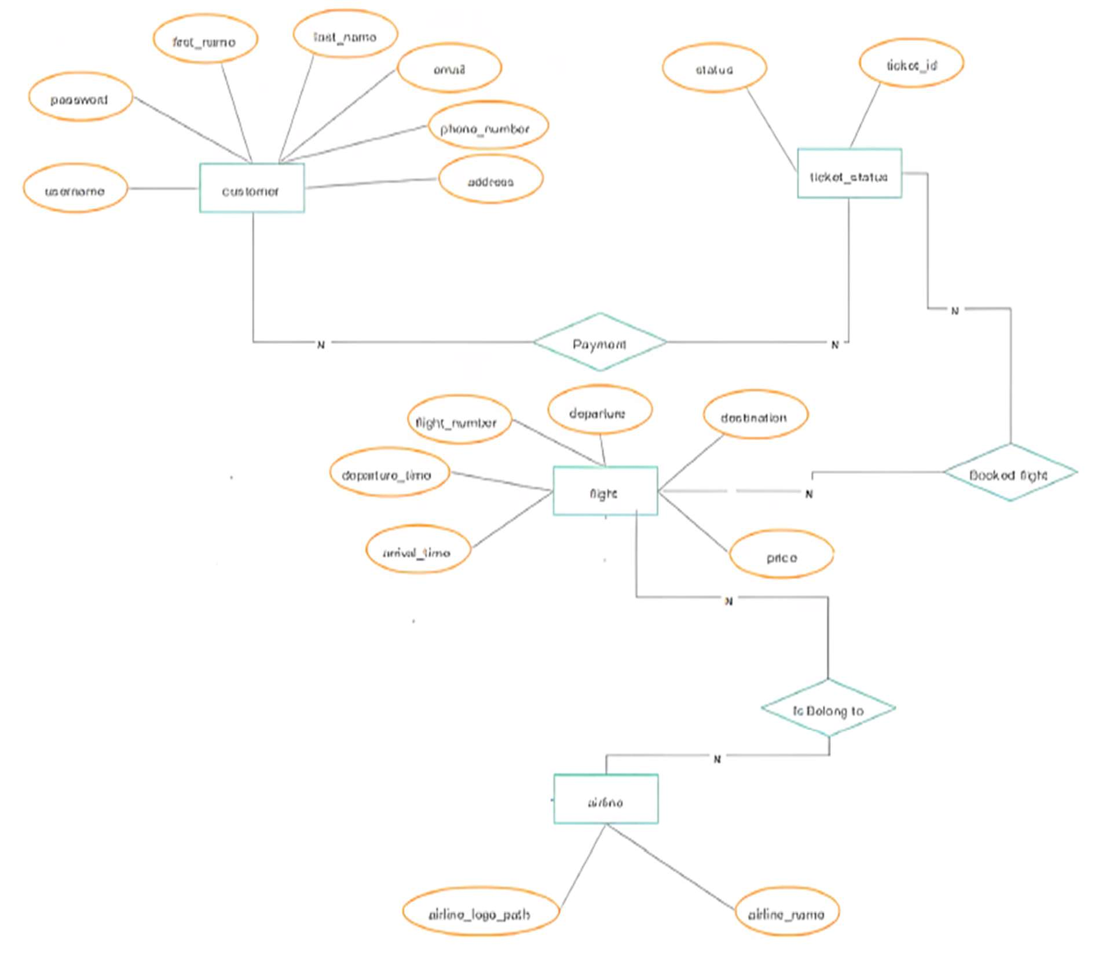
BANGALORE TECHNOLOGICAL INSTITUTE Department of Computer Science & Engineering
FIG. ENTITY RELATIONSHIP FOR AIRLINE MANAGEMENT

Slide 9
BANGALORE TECHNOLOGICAL INSTITUTE Department of Computer Science & Engineering
DATA FLOW DIAGRAM

Slide 10
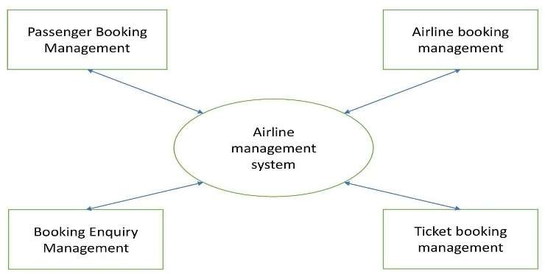
BANGALORE TECHNOLOGICAL INSTITUTE Department of Computer Science & Engineering
Level O DFD

Slide 11
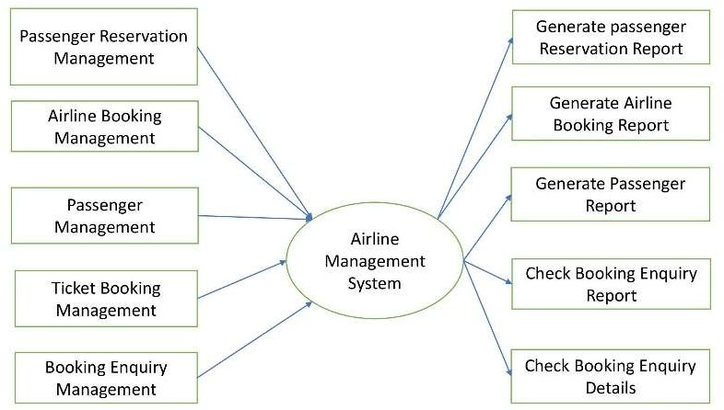
BANGALORE TECHNOLOGICAL INSTITUTE Department of Computer Science & Engineering
Level 1 DFD

Slide 12
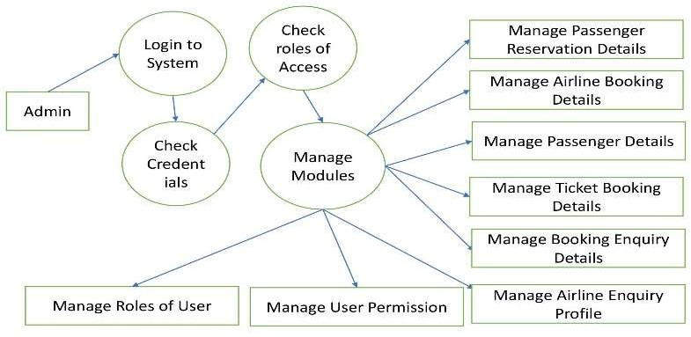
BANGALORE TECHNOLOGICAL INSTITUTE Department of Computer Science & Engineering
Level 2 DFD

Slide 13
BANGALORE TECHNOLOGICAL INSTITUTE Department of Computer Science & Engineering
DATA DICTIONERY
CONTINUED

Slide 14
BANGALORE TECHNOLOGICAL INSTITUTE Department of Computer Science & Engineering
Airline
Name | Null? | Type
Id | Not Null | Number
Type Name |  | Varchar

Slide 15
BANGALORE TECHNOLOGICAL INSTITUTE Department of Computer Science & Engineering
AIRLINE_TYPE
Name | Null? | Type
Type Name | Not Null | Varchar
Max Seat |  | Number
Company |  | Varchar

Slide 16
BANGALORE TECHNOLOGICAL INSTITUTE Department of Computer Science & Engineering
AIRPORT
Name | Null? | Type
Code | Not Null | Number
Name |  | Varchar
Country |  | Varchar
City |  | Varchar
State |  | Varchar

Slide 17
BANGALORE TECHNOLOGICAL INSTITUTE Department of Computer Science & Engineering
BOOKED LEG
Name | Null? | Type
Ticked ID | Not Null | Varchar
Flight Leg ID |  | Varchar
Flight No. |  | Number

Slide 18
BANGALORE TECHNOLOGICAL INSTITUTE Department of Computer Science & Engineering
CAN LAND
Name | Null? | Type
Airport Code | Not Null | Number
Airplane Type |  | Varchar

Slide 19
BANGALORE TECHNOLOGICAL INSTITUTE Department of Computer Science & Engineering
CREW
Name | Null? | Type
SSN | Not Null | Varchar
Name |  | Varchar
Gender |  | Char
Job |  | Varchar
Airplane ID |  | Varchar

Slide 20
BANGALORE TECHNOLOGICAL INSTITUTE Department of Computer Science & Engineering
CUSTOMER
Name | Null? | Type
FName | Not Null | Varchar
InName |  | Varchar
Phone no. |  | Number
Customer ID |  | Varchar

Slide 21
BANGALORE TECHNOLOGICAL INSTITUTE Department of Computer Science & Engineering
FLIGHT
Name | Null? | Type
Flight Number | Not Null | Number
Airplane ID |  | Varchar

Slide 22
BANGALORE TECHNOLOGICAL INSTITUTE Department of Computer Science & Engineering
FLIGHT LEG
Name | Null? | Type
Flight Number | Not Null | Number
Leg Number |  | Number
Department Airport Code |  | Varchar
Departure Time |  | Time
Arrival Airport Code |  | Varchar
Arrival Time |  | Time

Slide 23
BANGALORE TECHNOLOGICAL INSTITUTE Department of Computer Science & Engineering
TICKET
Name | Null? | Type
Ticket ID | Not Null | Varchar
Customer ID |  | Varchar
Class |  | Varchar
Amount |  | Number
Seat No. |  | Number
Date |  | Date

Slide 24
BANGALORE TECHNOLOGICAL INSTITUTE Department of Computer Science & Engineering
SCREEN LAYOUTS

Slide 25
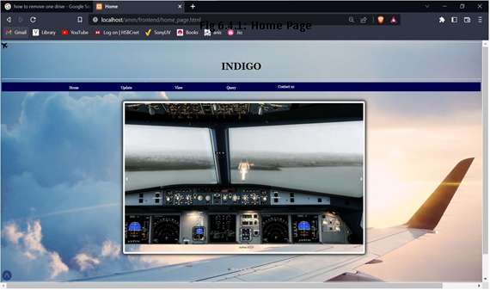
BANGALORE TECHNOLOGICAL INSTITUTE Department of Computer Science & Engineering

Slide 26
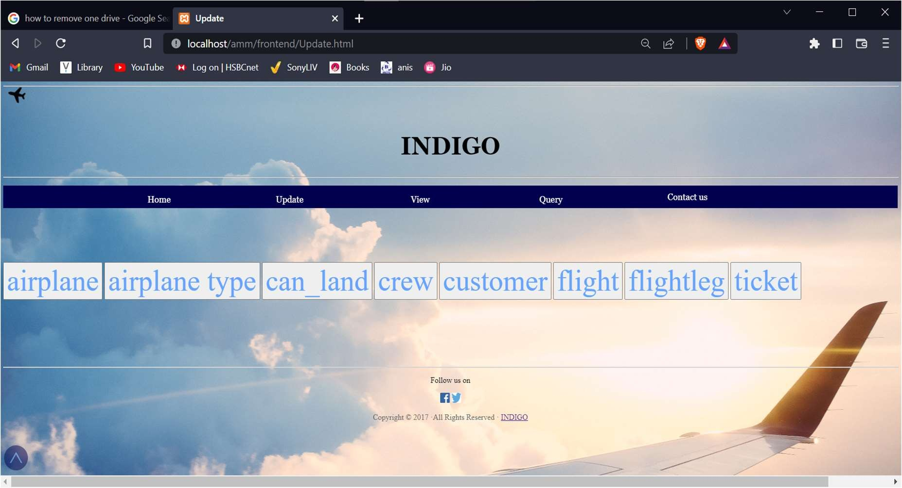
BANGALORE TECHNOLOGICAL INSTITUTE Department of Computer Science & Engineering

Slide 27
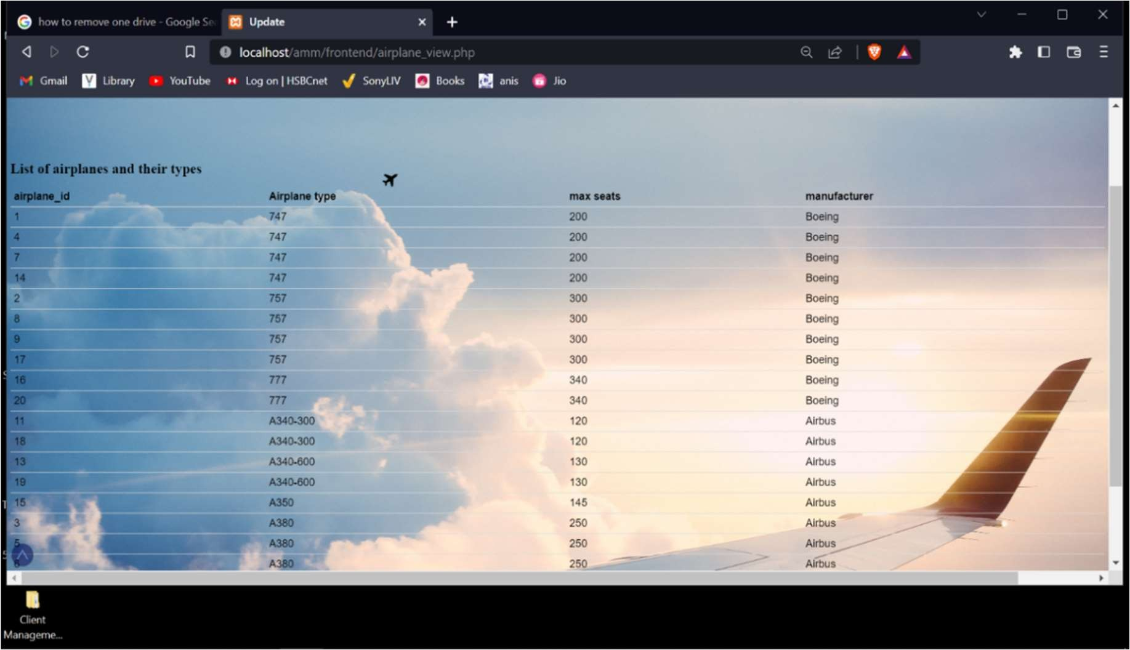
BANGALORE TECHNOLOGICAL INSTITUTE Department of Computer Science & Engineering

Slide 28
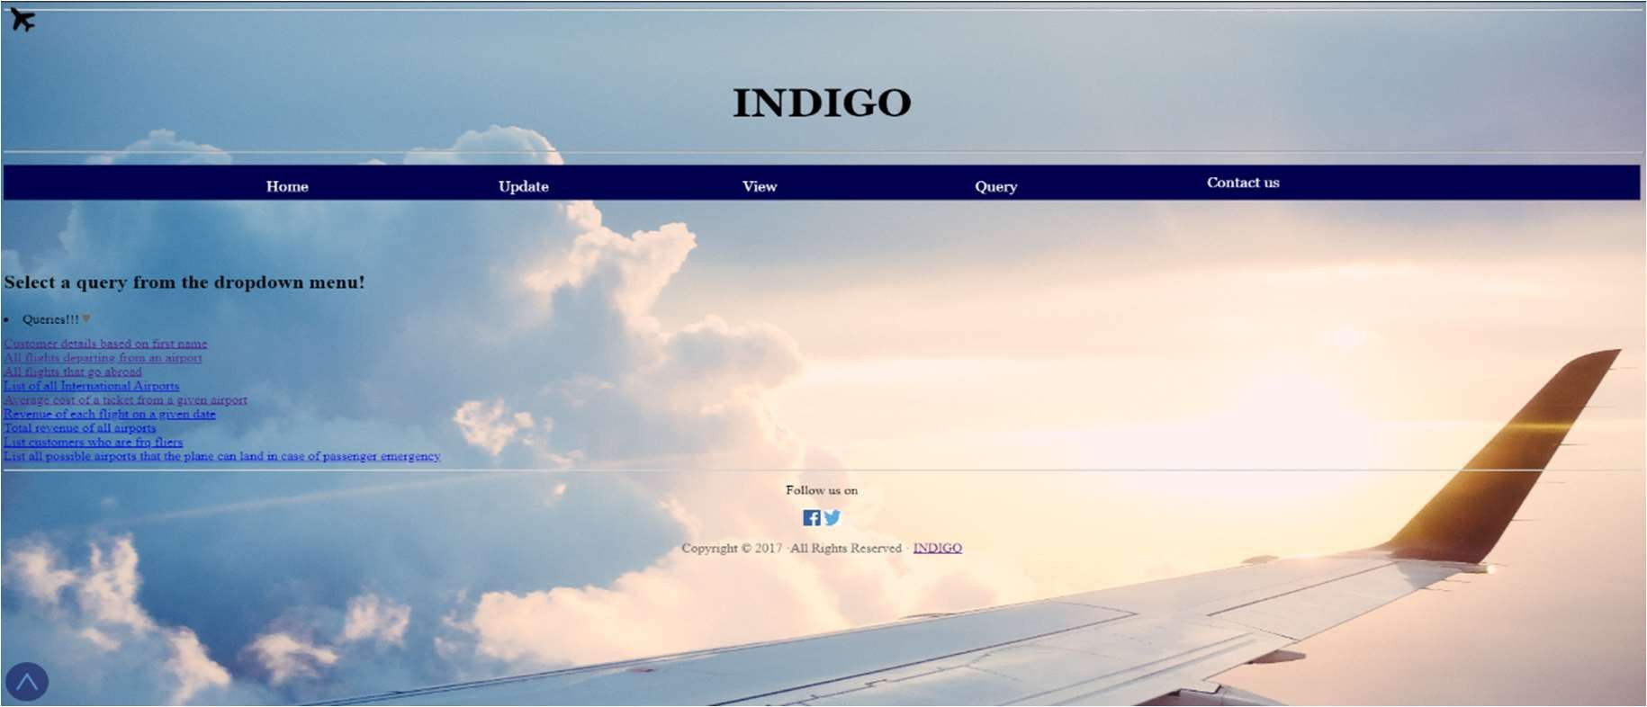
BANGALORE TECHNOLOGICAL INSTITUTE Department of Computer Science & Engineering

Slide 29
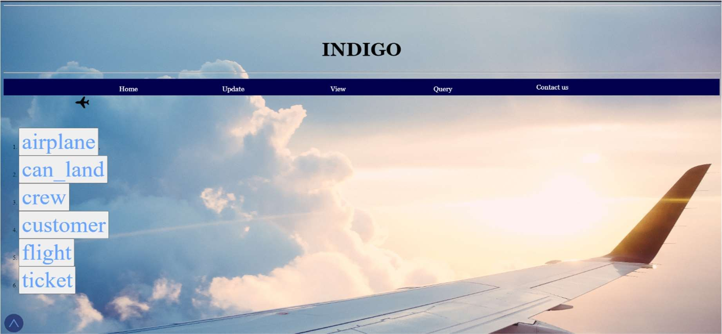
BANGALORE TECHNOLOGICAL INSTITUTE Department of Computer Science & Engineering

Slide 30
BANGALORE TECHNOLOGICAL INSTITUTE Department of Computer Science & Engineering
CONCLUSION

Slide 31
BANGALORE TECHNOLOGICAL INSTITUTE Department of Computer Science & Engineering
CONCLUSION
Airline Reservation System make the life of passengers very easy as the don’t need to stand in queues for getting their seats reserved and they can easily make reservations on any point of time and any airline just from a single system.
The purpose of Airline reservation system project is to build an website program which could use to manage the reservation of airlines ticket.

Slide 32
BANGALORE TECHNOLOGICAL INSTITUTE Department of Computer Science & Engineering
FUTURE SCOPE OF THE WORK
By creating this website we plan to provide a faster interface to the passengers.
Modified versions of older version that are pretty slow and complicated
Easy to use
Provide an easy access to different airlines around the world.
More secured

Slide 33
BANGALORE TECHNOLOGICAL INSTITUTE Department of Computer Science & Engineering
THANK YOU…

